Slide 1
SINGLA Emma
23rd North American symposium on dairy sheep milk production
Genetic improvement in the Lacaune milk breed

Slide 2
Plan
Lacaune breed history
Racial organization
Selection program
Genetic evolutions
Results of the sector-wide distribution
Future orientations

Slide 3
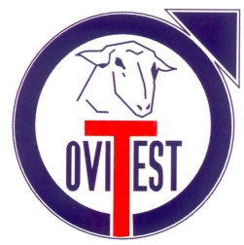
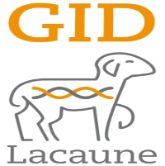
History
Organization
Selection prog.
Genetic evolutions
Results
Orientations
Conclusion
Lacaune breed organization
Milk
800 000 sheep
Two breeds
Meat
250 000 sheep
Meat testing/milk support
Distribution AI meat
1 selection program
170 000 sheep
2 selection programs
17 000 sheep
Complementary schemas
2 selection companies
2 selection companies

Slide 4
History
History
Organization
Selection prog.
Genetic evolutions
Results
Orientations
Conclusion

Slide 5
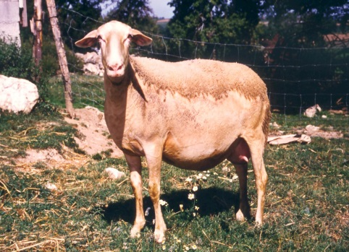
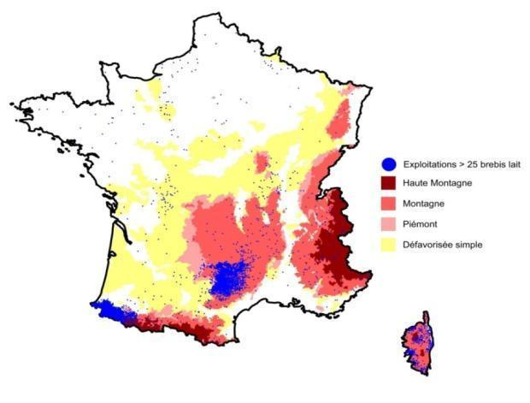
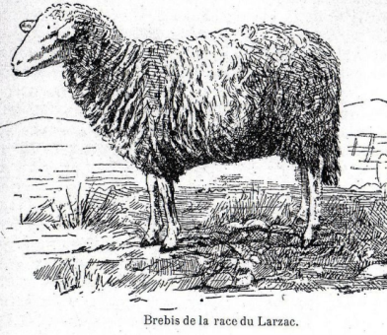
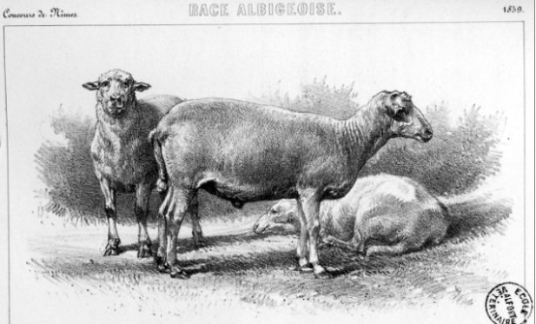
History
Organization
Selection prog.
Genetic evolutions
Results
Orientations
Conclusion
THE “LACAUNE” BREED
2 breeds
- Milk Lacaune
-Meat Lacaune
- Stemming from many small local breeds…
- Officially recognized in 1893
Lacaune milk breed:
800 000 sheep in France, more than 2000 breeders
AOP associated to the breed: Roquefort cheese
AOP: Appellation d’Origine Contrôlée

Slide 6
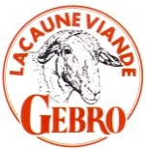
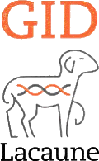
History
Organization
Selection prog.
Genetic evolutions
Results
Orientations
Conclusion
THE “LACAUNE” BREED: EVOLUTION
Milk recording
Meat branch
CIA Ovitest
Flock book
Stud rams
CIA Roquefort confederation
1947
1957
1959
1969
1970
1972
1974
1976
1980
2011
1st milk ES
2nd milk ES
Meat schema
Meat schema
FSL Breed
LACAUNE
Lacaune Milk Branch/Lacaune Milk Breed
OVI TEST
Lauraguais
Larzac
Camarès
GID Lacaune

Slide 7
History
Organization
Selection prog.
Genetic evolutions
Results
Orientations
Conclusion
Breed organization

Slide 8
History
Organization
Selection prog.
Genetic evolutions
Results
Orientations
Conclusion
From 1947 to 1980 selection tools in place:
Collective action to pool resources and share genetic gain
At the service of breeders and sheep sector

Slide 9
History
Organization
Selection prog.
Genetic evolutions
Results
Orientations
Conclusion
Organizing the selection
At the breeder level:
UPRA Lacaune (sector) (Lacaune breed unit)
● Breed orientation
● Coordination
Selection companies: Ovi Test and Confédération de Roquefort
● Manage creation and genetic distribution for breeders
At the organization level:
INRA (National institute of agronomic research)
● Research
● Genetic evaluation of breeders
Institut de l’Élevage (IDELE)
● Technical and methodological support to technical organizations
● Studies or research in collaboration with the INRA

Slide 10
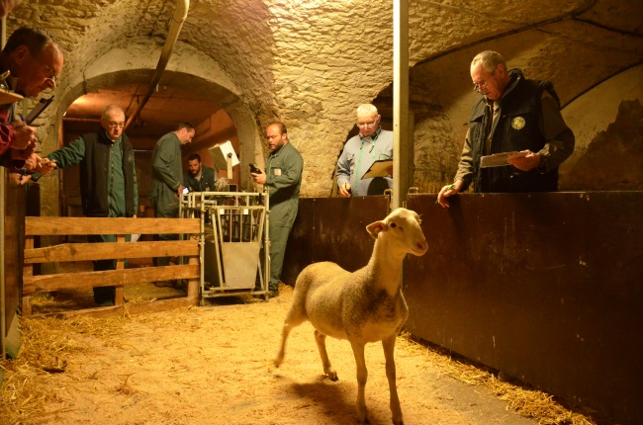
History
Organization
Selection prog.
Genetic evolutions
Results
Orientations
Conclusion
Methods in place for the selection schema operation
Two breeding centres for young rams
Selection of 3000 young rams stemming from AI calculated mating (in the breeding centres/genotyping)
¼ superior (roughly 700) retained for progeny evaluation
Distributed by AI; 1900 sold to breeders
170 000 sheep from 364 OMR husbandries (official milk recording)/4500 pre-selected rams
250 best rams retained as improvers

Slide 11
History
Organization
Selection prog.
Genetic evolutions
Results
Orientations
Conclusion
Methods in place for the selection schema operation
Two insemination centres
560 000 AIs in the Lacaune milk breed
400 000 inseminations annually with a genetic goal
1 000 rams favourably indexed in AI centres
Reference population 8 812 rams (in 2016)
➔ Genetic variability management

Slide 12
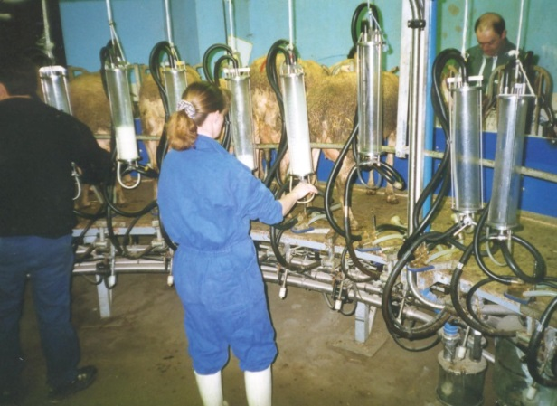
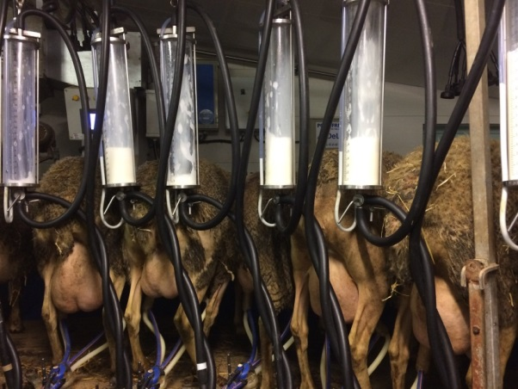
History
Organization
Selection prog.
Genetic evolutions
Results
Orientations
Conclusion
Methods in place for the selection schema operation
Milk recording
As of 1955, development of milk recording tools:
Adapted to the ovine species
Reasonable cost

Slide 13
History
Organization
Selection prog.
Genetic evolutions
Results
Orientations
Conclusion
Methods in place for the selection schema operation
Official milk recording
Nursing – 1 month
Exclusive milking – 2X day
M1
M2
M3
M4
M5
M6
MX
As of 1965
Quantitative control on all
X
X
X
X
X
X
(X)
1 monthly control on 1 daily milking + milk tank from 2 milkings
2 to 3% precision loss vs. a sample over 2 milkings/genetic correlation: 0.99
In 1985
Qualitative control
Fat + Protein + Cells on two first lactations
X
X
X
Collection from 2 to 3 samples
Fat, Protein: 10 to 20% precision loss/genetic correlation: 0.96 to 0.99
SCC: 2 to 3% precision loss/genetic correlation: 0.98
Udder/Teat score
X
Result: Lactation summary results, and sheep and ram genetic index

Slide 14
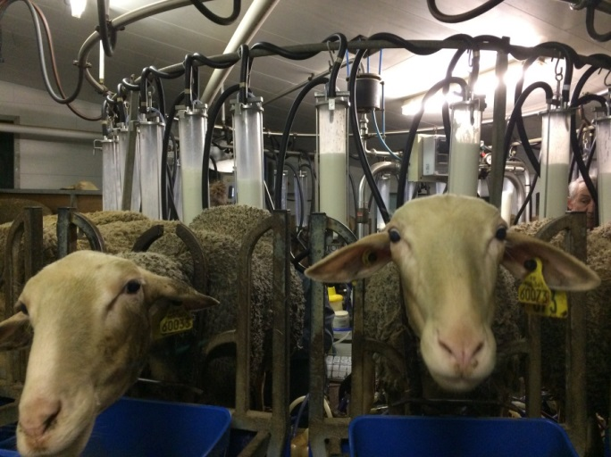
History
Organization
Selection prog.
Genetic evolutions
Results
Orientations
Conclusion
Methods in place for the selection schema operation
Simplified milk recording
Done in user husbandries
Only milk quantity
2 to 4 milk quantity controls per husbandry per year
Goal: Categorize sheep by intra herd groups to manage turnover and culling.

Slide 15
History
Organization
Selection prog.
Genetic evolutions
Results
Orientations
Conclusion
Selection organization
Interest in the experimental units
INRA La Fage
Representative husbandry systems
Milk quantity
Useful matter content
Dietary efficiency…
Production and efficiency characteristics
Functional traits
Teat/Udder health and morphology
Resistance to disease and paratism
Longevity…
Innovative breeding systems
Anticipate tomorrow’s characteristics
Once-a-day milking
Divergent ligneages (genetic differences between high and low lineages other than those selected)

Slide 16
History
Organization
Selection prog.
Genetic evolutions
Results
Orientations
Conclusion
Selection program
Three pillars of genetic improvement:
Shared objectives (sectors)
Performance measures
Collective organization

Slide 17
History
Organization
Selection prog.
Genetic evolutions
Results
Orientations
Conclusion
Selection schema operating principle
Pyramidal organization of the population (2016)
363 husbandries
172 000 sheep
23% of the population
Selectors
Official milk recording
300 husbandries
110 000 sheep
1 179 husbandries
508 000 sheep
Users
Simplified milk recording and inventory tracking
No technical monitoring
Tracking and MR: 86% of sheep tracked, more than 90% of the milk from the Roquefort sector - Distribution: 400 000 genetic AIs/year

Slide 18
History
Organization
Selection prog.
Genetic evolutions
Results
Orientations
Conclusion
Selection schema history
Chronology of criteria taken into account in dairy selection
Rationalize selection objectives over time
Genomic selection starting in 2015
1957
Milk quantity
1995
Resistance to scrapie
2000
Udder morphology
2006
ISOL
50% functional
50% production
1985
Milk quality
Fat, protein, UDM
1999
Somatic cells SCC

Slide 19
History
Organization
Selection prog.
Genetic evolutions
Results
Orientations
Conclusion
Selection schema history
Chronology of criteria taken into account in dairy selection
Rationalize selection objectives over time
Genomic selection starting in 2015
1957
Milk quantity
1995
Resistance to scrapie
2000
Udder morphology
2006
ISOL
50% functional
50% production
1985
Milk quality
Fat, protein, UDM
1999
Somatic cells SCC

Slide 20
History
Organization
Selection prog.
Genetic evolutions
Results
Orientations
Conclusion
Sanitary tracking for healthy semen and breeder distribution
Lacaune selector herds
Brucellosis
Maedi-visna
Border disease
Scrapie
Programme national de lutte contre la Tremblante
All rams registered ARR/ARR (resistant) since 2003
Partners: Selection companies, GDS and FRGDS (health tracking groups) from the departments and regions associated to the breed, veterinarians, departmental laboratories.

Slide 21
History
Organization
Selection prog.
Genetic evolutions
Results
Orientations
Conclusion
Selection schema history
Chronology of criteria taken into account in dairy selection
Rationalize selection objectives over time
Genomic selection starting in 2015
1957
Milk quantity
1995
Resistance to scrapie
2000
Udder morphology
2006
ISOL
50% functional
50% production
1985
Milk quality
Fat, protein, UDM
1999
Somatic cells SCC

Slide 22
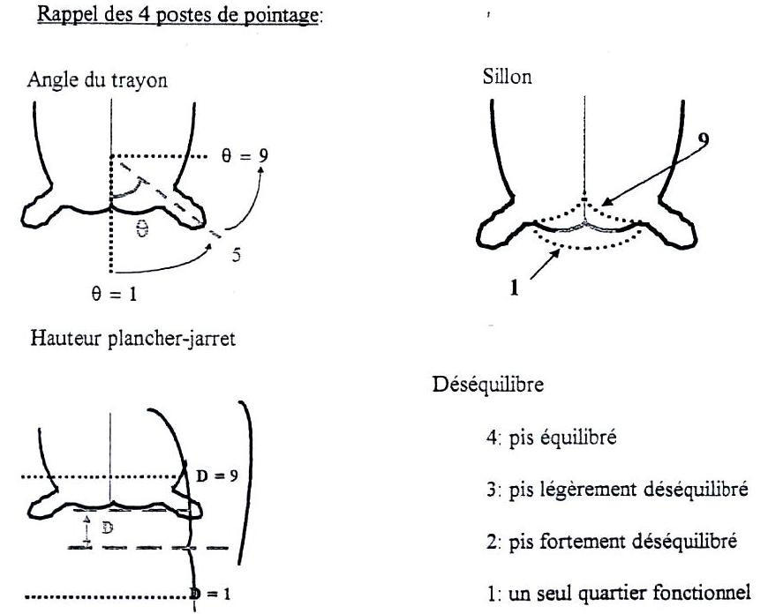
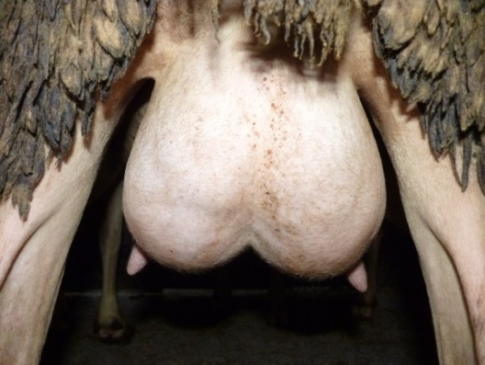
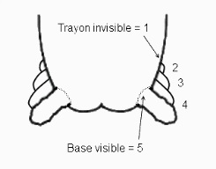
History
Organization
Selection prog.
Genetic evolutions
Results
Orientations
Conclusion
Selection schema orientation
INDEX Synthétique Ovin Lait ISOL (Synthetic Ovine Milk Index) since 2006
- Milk
50% production characterisitics
-Protein content
ISOL
-Fat content
50 % functional characteristics
- Somatic cells
- Udder
5th placement since 2013 - Teat position

Slide 23
History
Organization
Selection prog.
Genetic evolutions
Results
Orientations
Conclusion
Selection schema orientation
Udder morphology –index evolution (2017)
Note: high index = favourable / low index = unfavourable

Slide 24
History
Organization
Selection prog.
Genetic evolutions
Results
Orientations
Conclusion
Example: Genetic correlations between chosen characteristics
Lacaune sheep - Aptitude for milking machine
Milking speed
Mammary gland morphology (Milking ease)
MILK quantity
Udder health (SCC)
Characteristics integrated into ISOL
Genetic correlations:
Favourable
Unfavourable
Source : INRA

Slide 25
History
Organization
Selection prog.
Genetic evolutions
Results
Orientations
Conclusion
Selection schema history
Chronology of criteria taken into account in dairy selection
Rationalize selection objectives over time
Genomic selection starting in 2015
1957
Milk quantity
1995
Resistance to scrapie
2000
Udder morphology
2006
ISOL
50% functional
50% production
1985
Milk quality
Fat, protein, UDM
1999
Cellules somatiques CCS

Slide 26
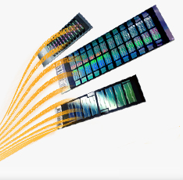
History
Organization
Selection prog.
Genetic evolutions
Results
Orientations
Conclusion
Genomic selection principle
8 months:
start testing
Birth ♂
Breeding choice
2.5 yrs:
progeny index
Not precise:
Do not have individual’s origin/Only have both parents’ average
54K Genotyping → genomic index choice at 4 mths
Choice of progeny
(OMR + scores)
More precise:
Part of individual’s origin is estimated
Precise:
individual’s origin is estimated thanks to the girls
Quicker knowledge of the rams’ results =
shorter generation interval (- 2.5 yrs )
Improver rams used as of the first year on the genomic index (approx. 6 mths)

Slide 27
History
Organization
Selection prog.
Genetic evolutions
Results
Orientations
Conclusion
Precision of a genomic index
Breeding index
Genomic GBLUP index
Progeny index
(after testing)
0.20-0.30
0.45-0.55
0.60-0.70
CD
CD
depending on characteristic
CD
Genomic selections offer 15 to 20% more genetic gain than a conventional schema

Slide 28
History
Organization
Selection prog.
Genetic evolutions
Results
Orientations
Conclusion
Overall service to complement genetic services
Technical services
Technical and techno-economic reports, production costs
Nutrition support
Milk quality support:
fat content, protein content, somatic cells
Take part in studies and R&D programs
Reproduction support, response plan
Animal insemination

Slide 29
History
Organization
Selection prog.
Genetic evol.
Results
Orientations
Conclusion
Genetic evolutions

Slide 30
History
Organization
Selection prog.
Genetic evol.
Results
Orientations
Conclusion
Evolution of Lacaune ram indexes
Milk, fat, protein (2017 index averages)
ΔG MILK annually:
1980 -1990: 7.3 litres 1991-2000: 5.5 litres 2001-2006: 4.5 litres 2007-2015: 4.5 litres
ΔG Fat & protein annually:
1991-2000: 0.26 g/l & 0.20 g/l 2001-2006: 0.18 g/l & 0.13 g/l
2007-2015: 0.22 g/l & 0.19 g/l

Slide 31
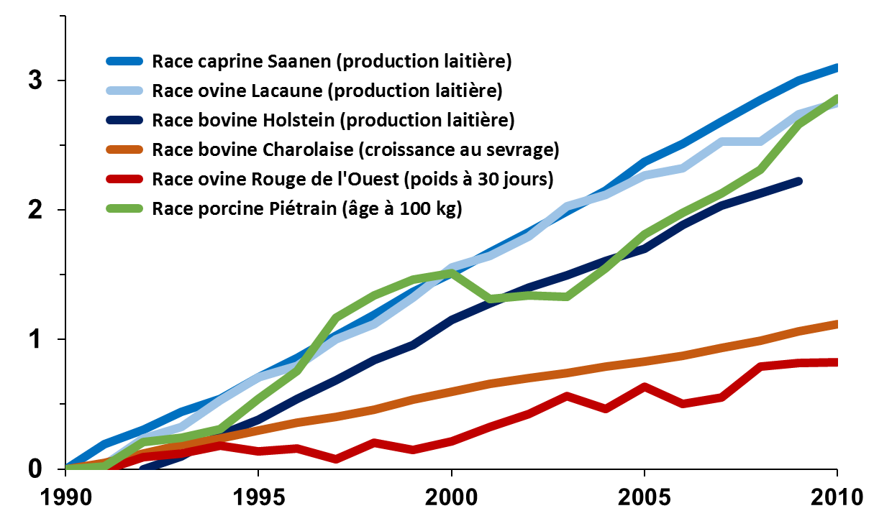
History
Organization
Selection prog.
Genetic evol.
Results
Orientations
Conclusion
Selection efficiency
Compared evolution of the genetic average over time in France
(in standard deviation units per genetic characteristic)
Source: INRA and Technical Institutes
E. Verrier et al., CIOC, Saint-Affrique, 8-9 avril 2015

Slide 32
History
Organization
Selection prog.
Genetic evol.
Results
Orientations
Conclusion
Genetic evolution and middle 2017
Milk in first lactation
2000-2017 ΔP annually: 2.8 litres ΔG annually: 4.5 litres

Slide 33
History
Organization
Selection prog.
Genetic evol.
Results
Orientations
Conclusion
Genetic evolution
Morphology index udder / cells
Rate of genetic gain since 2005:
SCC: 0.088 σg
MAM: 0.059 σg
Note: high index = favourable / low index = unfavourable

Slide 34
History
Organization
Selection prog.
Genetic evol.
Results.
Orientations
Conclusion
Results of the sector-wide distribution of genetic gain

Slide 35
History
Organization
Selection prog.
Genetic evol.
Results.
Orientations
Conclusion
Concentrate reduction in ewes’ feeding

Slide 36
History
Organization
Selection prog.
Genetic evol.
Results.
Orientations
Conclusion
Reduction in amount of forage purchased

Slide 37
History
Organization
Selection prog.
Genetic evol.
Results.
Orientations
Conclusion
Increase in milk production

Slide 38
History
Organization
Selection prog.
Genetic evol.
Results.
Orientations
Conclusion
Lacaune: Compared evolution between tank fat content of OMR flocks (selectors) and SMR (users)
Tank fat content: sources SIEOL technical support

Slide 39
History
Organization
Selection prog.
Genetic evol.
Results.
Orientations
Conclusion
Lacaune: Compared evolution between tank protein content of OMR flocks (selectors) and SMR (users)
Tank protein content: sources SIEOL technical support

Slide 40
History
Organization
Selection prog.
Genetic evol.
Results.
Orientations
Conclusion
A powerful impact on the division
Richness of the Roquefort milk - 170 million litres/year
Selection objective
milk
Milk + richness
(sources: Confédération Générale de Roquefort)

Slide 41
History
Organization
Selection prog.
Genetic evol.
Results.
Orientations
Conclusion
Distribution of genetic gain
SCC: phenotypic evolution in the Lacaune breed
Selector breeders (OMR) versus users (SMR)

Slide 42
History
Organization
Selection prog.
Genetic evol.
Results
Orientations
Conclusion
Future orientations

Slide 43
History
Organization
Selection prog.
Genetic evol.
Results
Orientations
Conclusion
New, feasible objectives associated to the evolution of needs
Once-a-day milking
0.6 to 0.75 correlation between twice-a-day and once-a-day milking.
Aptitude associated to the udder’s internal morphology (cistern)
Cheesemakers’ yield and milk composition (+ soluble proteins)
Lactation persistence (increase in milking length per lactation)
Functional longevity (number of milking days from her first parturition to a certain age)

Slide 44
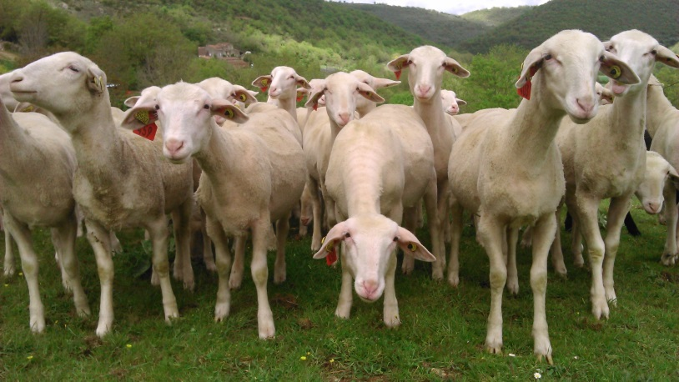
History
Organization
Selection prog.
Genetic evol.
Results
Orientations
Conclusion
New, feasible objectives associated to the evolution of needs
Fine milk composition (Phénofinlait study)
Fine milk composition estimate for ≈50 fatty acids, 7 proteins using MIR spectrum
Genetic analysis work being done
Resistance to parasites (gastrointestinal strongyles haemonchus contortus)
Ram infestation protocol in breeding centres

Slide 45
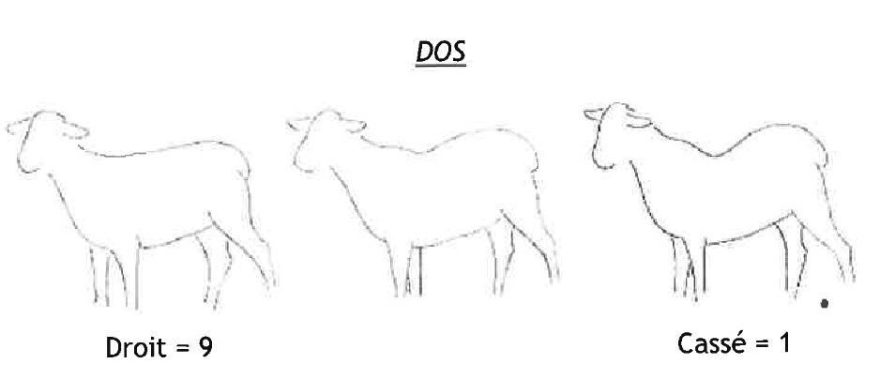
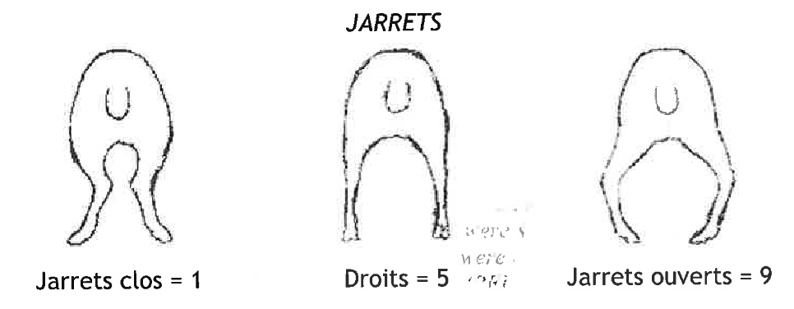
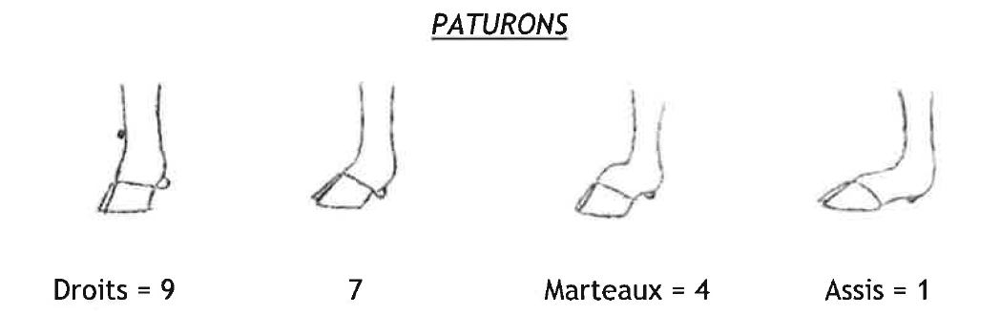
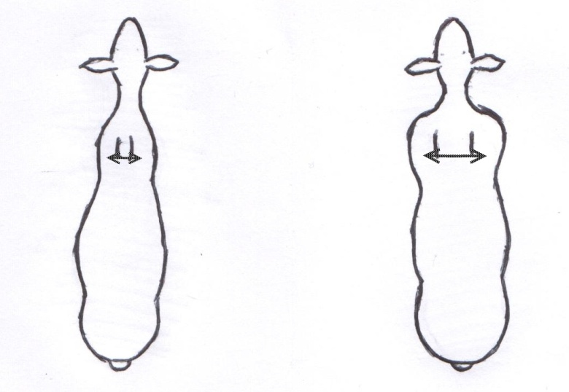
History
Organization
Selection prog.
Genetic evol.
Results
Orientations
Conclusion
New, feasible objectives associated to the evolution of needs
Standard breed characteristics for young rams in breeding centres in order to choose AI rams using ISOL indexation
Epaules
1
9

Slide 46
History
Organization
Selection prog.
Genetic evol.
Results
Orientations
Conclusion
Conclusion

Slide 47
History
Organization
Selection prog.
Genetic evol.
Results
Orientations
Conclusion
Annual genetic program synthesis
5.7 L milk
0.039 genetic standard deviation
morphology
0.12 g/L protein content
0.067 genetic standard deviation
SCC
0.16 g/L
fat content
All breeders resistant to scrapie carrying the PrP major gene, all rams R/R homozygous
Phenotypic results at the sector and breed level
+ milk,
+ fat content,
+ protein content,
+ mammary morphology and milking speed,
- SCC and decrease in sub-clinical mastitis,
+ dietary efficiency, ingestion capacity
Genetic gap between selection and users (3 to 5 yrs)

Slide 48
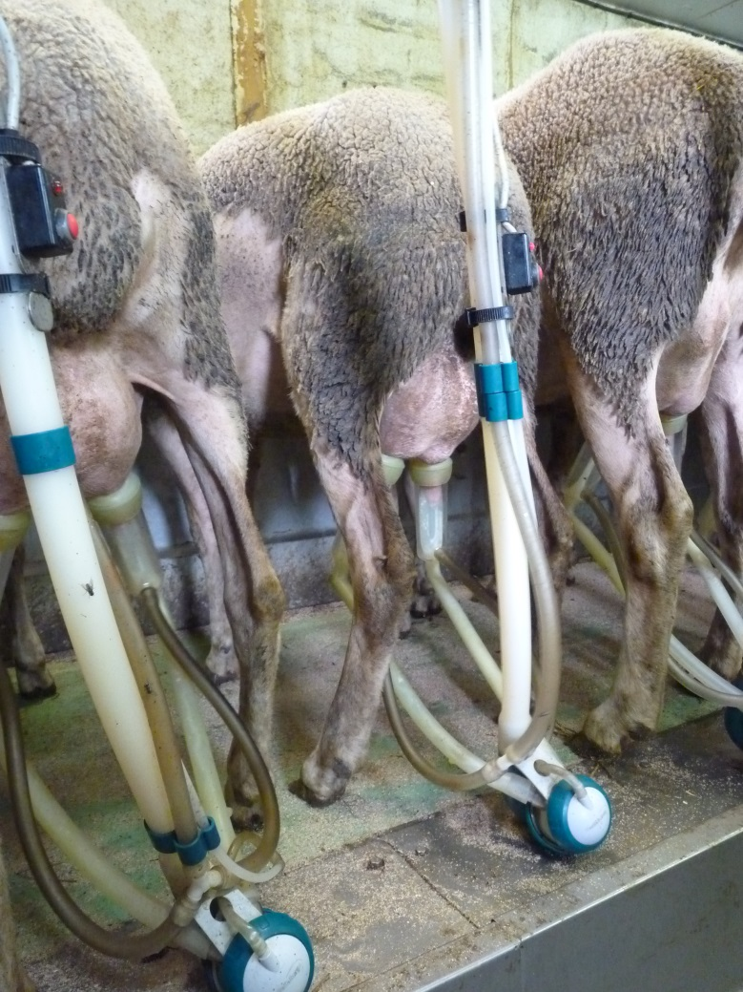
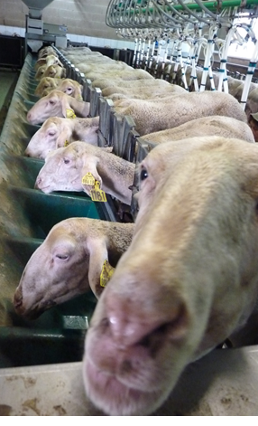
Thank you

